Slide 1
CS 725 PROJECT
MACHINE TRANSLATION
(English to Hindi)
Team Members
Yash Sunil Sadhwan - 23M0818
Swapnil Bhattacharyya - 23M0753
Ujjwal Sharma - 23M0837
Saral Sureka - 23M2113
Trivikram Vidya Umanath - 23D1596
Sneha Oram - 23M2159

Slide 2
TASK DESCRIPTION
Problem Statement - Language divergence in our country is rich, but hinders inclusivity among its people. Machine translation still remains a challenge even after several decades of its conceptualization.
Proposed solution approach - Neural Machine Translation (NMT) for translating the English language to the Hindi language using three architecture combinations to optimize translation accuracy.

Slide 3
CHALLENGES ADDRESSED
Base models(LSTM/GRU model) took long time for computing output.
Attention based model demanded of higher compute power.
The transformer model in itself took hours to be trained even with GPU compute.
We were not able to train on GPU1 server so we trained parallelly in Google Colab for 2 to 3 hrs.
The transformer model also had a larger size which made it difficult for training and deployment.

Slide 4
OUTLINE OF METHOD
Three architectures were used for modeling -
Vanilla Encoder Decoder model - LSTM/GRU without attention
Dataset was trimmed to 97471 sentence pairs
Encoder Decoder model with Attention Decoder
Dataset was trimmed to 97471 sentence pairs
Transformer model
Trained different models with 150k, 200k, 250k and 300k sentence pair parallel corpus
After preprocessing the datasets were trimmed to ~90k , ~135k , ~169k and ~200k sentence pairs
GitHub Repository - https://github.com/ujjwalsharmaIITB/FML-Project-NMT-En-Hi.git

Slide 5
EXPERIMENT DETAILS AND MAIN RESULTS
Dataset - IIT Bombay Hindi English Corpus
Data Preprocessing - Building vocabulary, converting sentence to tensors, removing code-mixed sentences, null pairs, punctuations, lower casing, changing encoding of sentence, maintaining maximum sentence length.
Modelling -
Vanilla Encoder Decoder Model -
Encoder - LSTM/GRU with hidden size of 128, Embedding(52137, 128), GRU(128, 128, batch first=True)
Decoder - LSTM/GRU with hidden size of 128, Embedding(61973, 128), GRU(128, 128, batch first=True)
Time Taken: 134 mins

Slide 6
2. Encoder Decoder model with Attention Decoder -
Encoder - LSTM/GRU with hidden size of 128, Embedding(52137, 128), GRU(128, 128, batch first=True)
Decoder - LSTM/GRU with hidden size of 256, Embedding(61973, 128), Attention Mechanism(Bahdanau Attention), GRU(256, 128, batch first=True)
Time taken - 150m 30s
3. Transformer model (with 150k, 200k, 250k and 300k sentence pair)
Embedding size=512
Number of attention heads=8
One encoder and one decoder
dropout=0.10
Note :- We were able to train only 20 epochs for the transformers in Google Colab
For 200k ~ 97 mins ,250k ~ 132 mins , 300k ~ 178 mins

Slide 7
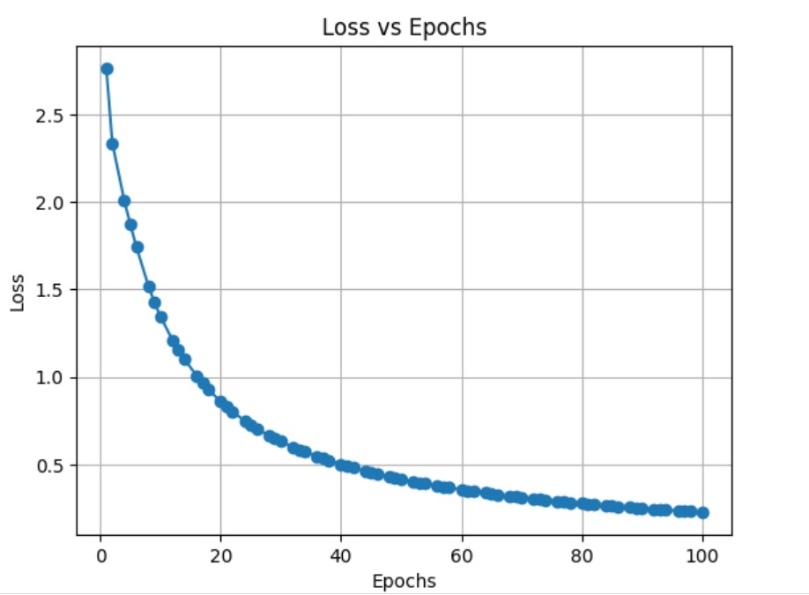
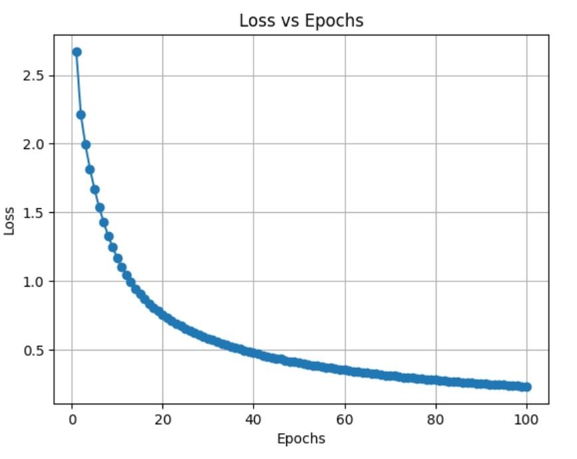
Loss (training) functions for sequence to sequence models
Loss function without attention
Loss function with attention

Slide 8
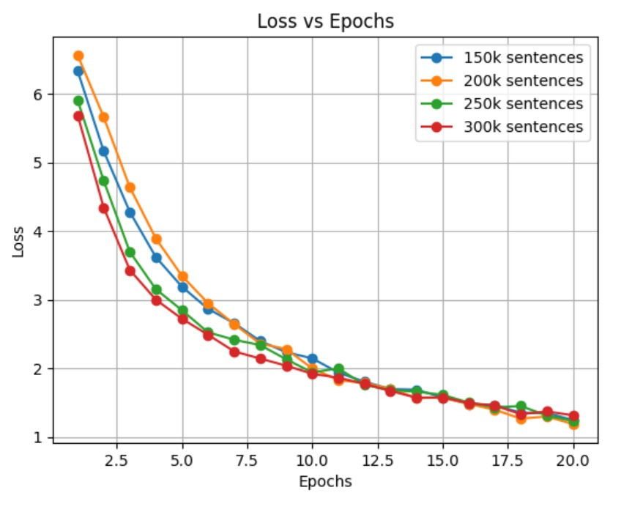
Loss function with Transformer model (with varying sentence pairs)

Slide 9
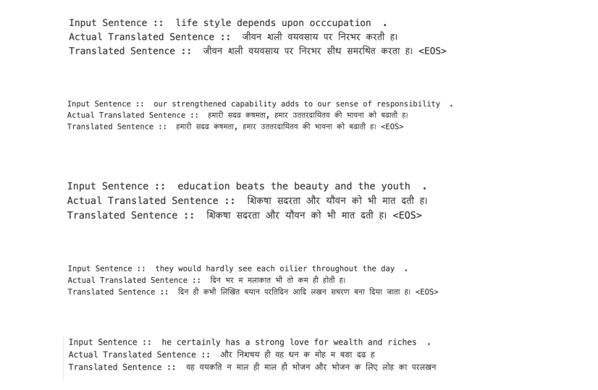
Translations from attention-based models
Translation from transformer (200k training instances)
English: <SOS> now jeevan dutt could speak out to the world without hesitation and say that it was a fact <EOS> <PAD> <PAD>
Actual: <SOS> जीवनदत्त ऊंची आवाज से घोषित कर सकते हैं कि यह सत्य है सत्य है। <EOS> <PAD> <PAD> <PAD> <PAD> <PAD> <PAD>
Predicted: जीवनदत्त ऊंची आवाज मिल सकता है और तब हमें उस समय दुनिया में जीत सकता है।

Slide 10
BLEU scores
Model/n-gram | 1-gram | 2-gram | n-gram
Transformer(200k) | 0.15(appr.) | 0.06 (appr.) | 0.01 (appr.)
Transformer(250k) | 0.166 (appr.) | 0.0736 (appr.) | 0.0125 (appr.)
Transformer(300k) | 0.168 (appr.) | 0.0749 (appr.) | 0.0125 (appr.)

Slide 11
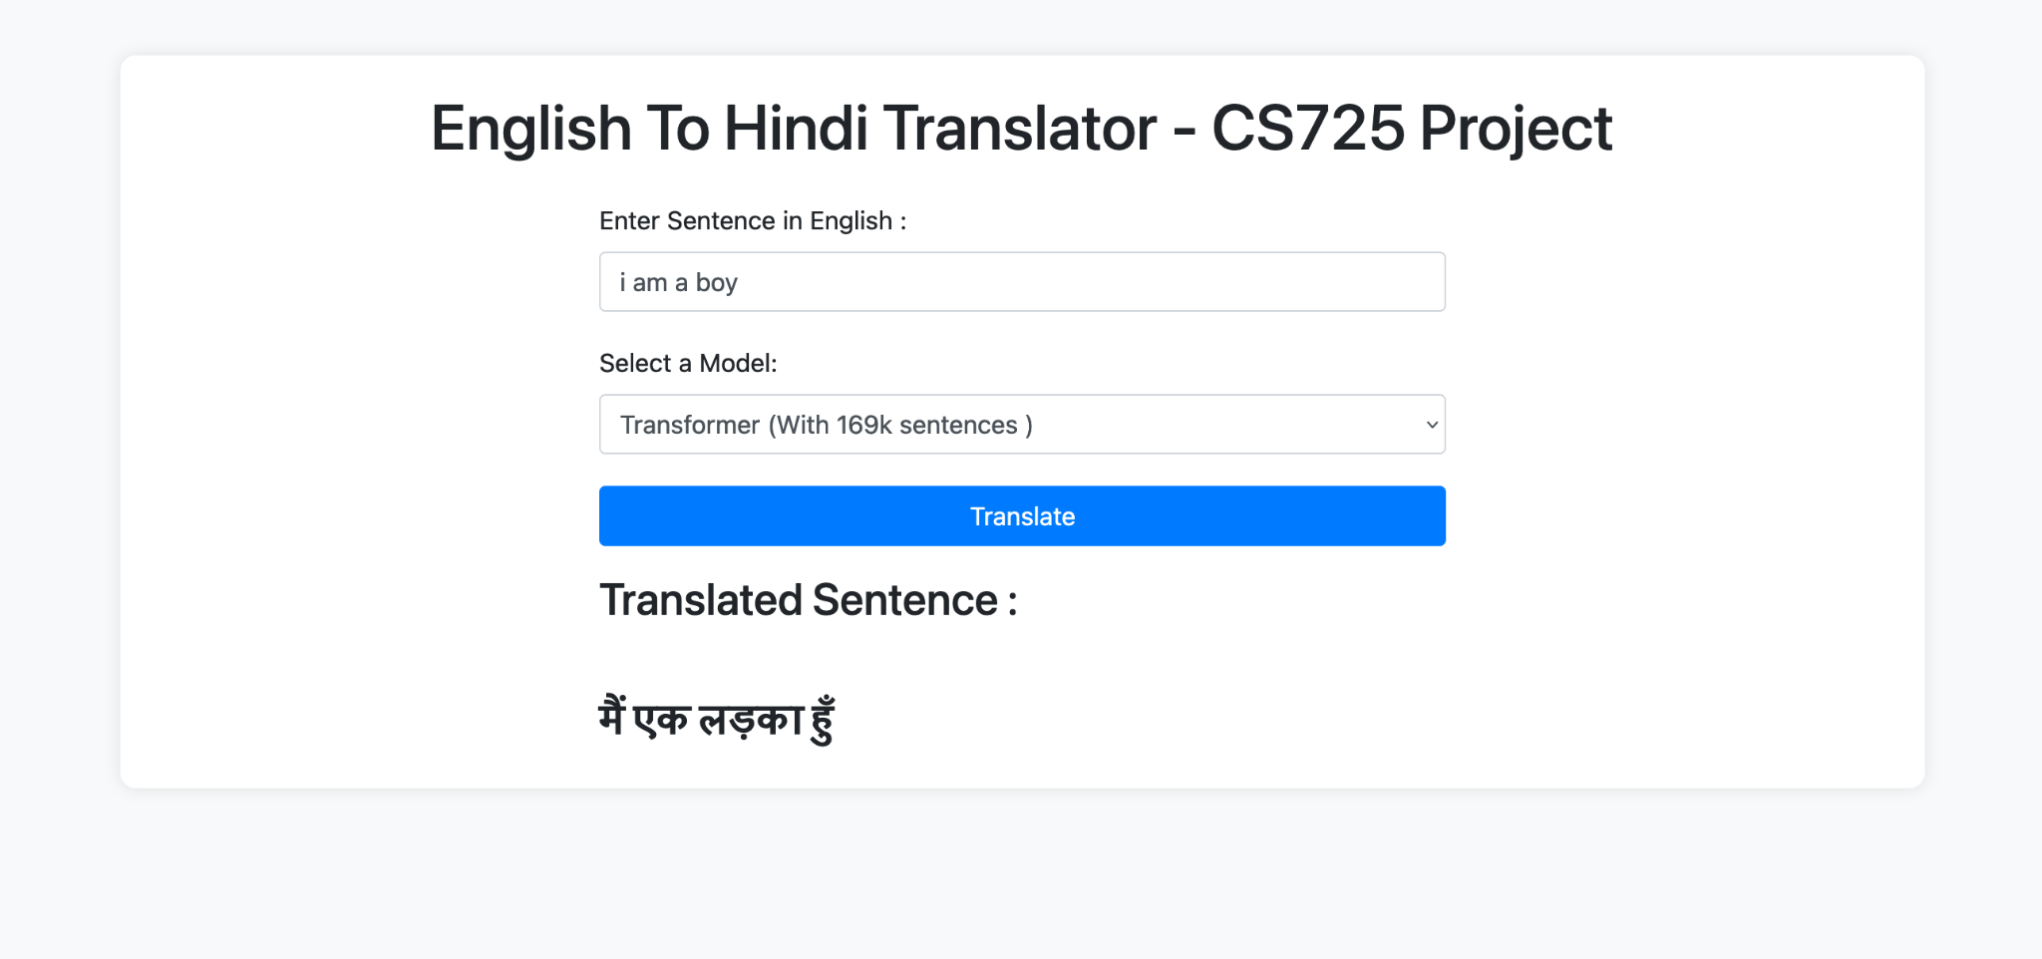
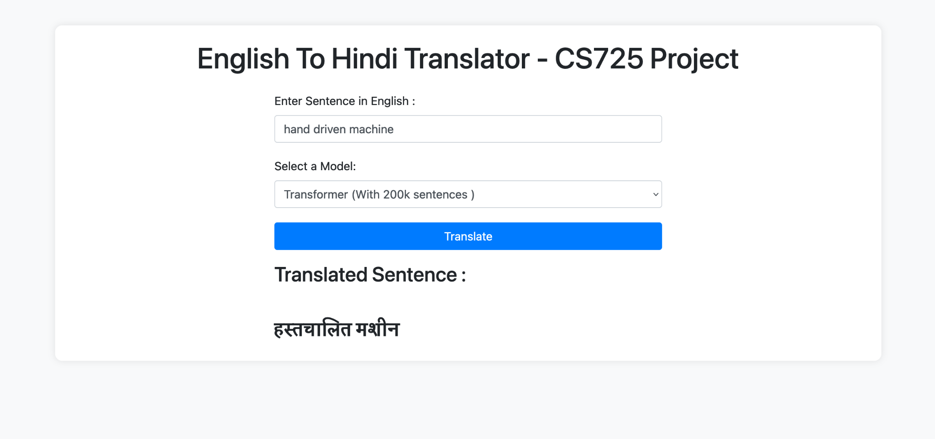
Deployment and Interface
We also made a interface (web application).
You can select from different models to fetch the translation

Slide 12
RELATED WORKS
J. Nair, K. A. Krishnan and R. Deetha, "An efficient English to Hindi machine translation system using hybrid mechanism," 2016 International Conference on Advances in Computing, Communications and Informatics (ICACCI), Jaipur, India, 2016, pp. 2109-2113, doi: 10.1109/ICACCI.2016.7732363.
S. Saini and V. Sahula, "Neural Machine Translation for English to Hindi," 2018 Fourth International Conference on Information Retrieval and Knowledge Management (CAMP), Kota Kinabalu, Malaysia, 2018, pp. 1-6, doi: 10.1109/INFRKM.2018.8464781.

Slide 13
CONCLUSION
Due to limited data and lack of huge compute support for machine translation, using RNNs and transformers, our models performed well enough on training sentences while it performed quite inaccurately on different sentences.
We noticed that the RNN models that were trained by “Teacher Forcing” were learning the correct english words but diverged a lot, this is somewhat controlled by incorporating attention mechanisms
Transformers performed much better than the RNN models on the same dataset and we were able to train on more data while having approximately the same training time.
Overall we tried to perform a study of how different models perform on same datasets and similar prompts.
We also deployed the model ( made a web application for translation ) using Flask .

Slide 14
WORK SPLIT UP AMONG TEAM MEMBERS
There was no strict division of tasks everyone contributed almost equally in training and reporting.The following areas are where contributions were more by the members:-
Coding, training models and analysis:-Ujjwal Sharma, Swapnil Bhattacharyya, Saral Sureka and Yash Sadhwan.
Reports, PPT, code survey, paper reading and team management:-Sneha Oram and Trivikram Vidhya Umanath

Slide 15
REFERENCES / LIBRARIES
Kyunghyun Cho, Dzmitry Bahdanau, Fethi Bougarehttps: "Learning Phrase Representations using RNN Encoder–Decoder for Statistical Machine Translation".
Ilya Sutskever, Oriol Vinyals, Quoc V. Le. "Sequence to Sequence Learning with Neural Networks".
Dzmitry Bahdanau, KyungHyun Cho Yoshua Bengio. "NEURAL MACHINE TRANSLATION BY JOINTLY LEARNING TO ALIGN AND TRANSLATE".
Ashish Vaswani, Noam Shazeer, Niki Parmar, Jakob Uszkoreit, Llion Jones, Aidan N. Gomez, Łukasz Kaiser, Illia Polosukhin. "Attention Is All You Need".
Library Used
Pytorch
Nltk
Matplotlib
Datasets ( for downloading IITB corpus )
Flask ( for deployment and ApiS )

Slide 16
REFERENCES / LIBRARIES ( contd.)
https://arxiv.org/abs/1706.03762
https://www.youtube.com/watch?v=iDulhoQ2pro
https://www.youtube.com/watch?v=TQQlZhbC5ps&t=636s
https://pytorch.org/tutorials/beginner/translation_transformer.html

